Slide 1
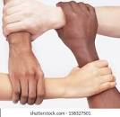
Diversity in Zonta
Ela Pandya
District 9 Conference 2023

Slide 2
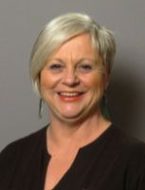
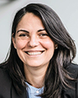
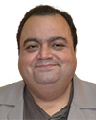
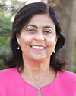
Z I Diversity Working Group under ZI Membership Committee
Sandy Venn-Brown
Australia
ZI and Zonta Foundation Director
Advisor to the Diversity Group
Madalina Paula Magnuson
Member, Zonta Club of Molndal,
Sweden
Errick Elavia, Chair
Member, Zonta Club of Mumbai, I
India
Ela Pandya
Member, Zonta Club of Porterville,
USA

Slide 3
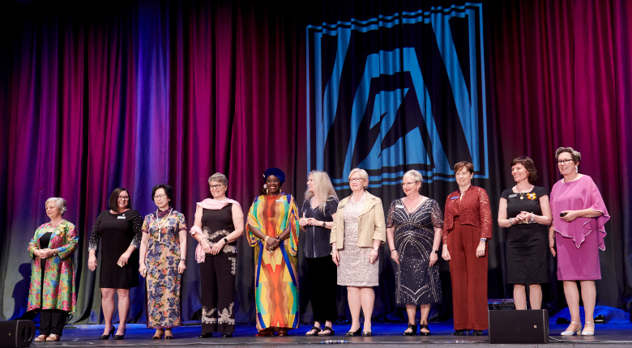
Biennial Goal
“Value diversity and respect of all backgrounds. We believe that fostering a diverse and inclusive global community is a powerful platform to bring about the social change needed to make our vision for gender equality a reality. A diverse community of Zontians is essential to our ability to achieve our mission to create a more equitable future, and we must strive harder to be an organization where everyone feels empowered to be their full authentic selves.”

Slide 4
Responsibilities of the Diversity Working Group
Inform clubs, area, districts about the ZI Diversity Statement
Demonstrate how diversity is an enrichment for a vibrant club life
Develop concrete ways and figure out best practices how clubs, areas, districts can implement the Diversity Statement
Collect interesting information for the ZI and Foundation Reference Library.
Write additional reports and other PR material for The Zonta, ZI website, Newsletters, and other media to support HQ Communication Department when required.
Inform Clubs about expected profiles of the membership.
Instruct Clubs to keep diversity practices in succession planning.

Slide 5
What is Diversity?
Diversity is the range of human differences, including but not limited to: race, ethnicity, gender, gender identity, sexual orientation, age, social class, physical ability or attributes, religious or ethical values system, national origin, and political beliefs.

Slide 6
Benefits of Diversity
Smarter decision-making. ...
An increase in profits and productivity. ...
Reduced rates of employee turnover. ...
Improved reputation for your business. ...
Be fair and identify potential bias. ...
Value all of your employees equally.
Better opportunities in creative problem solving

Slide 7
Foundations of Diversity*
Culture
• A culture consists of unwritten and written principles and laws that guide how an individual interacts with the outside world.
• They are then taught and reinforced by other members in the group.
• Which then becomes a shared system that is passed on from generation to generation.
Religion, rituals, traditions, etiquette, cuisine, language, beliefs are all examples of culture.
*From Heidi Moore’s presentation

Slide 8

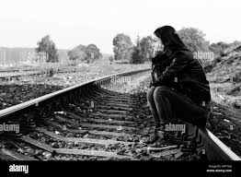
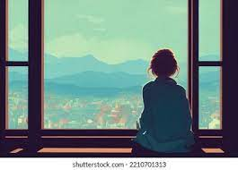
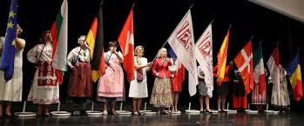
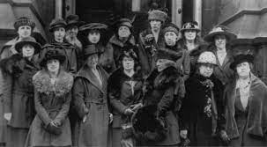
What does culture provide?
A
sense of
belonging.*
*From Heidi Moore’s presentation

Slide 9



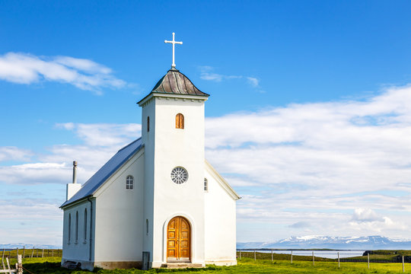

Spirituality of Diversity
Normalizing the Discussion
Acknowledge that people have choices.
The fact that a person chose Zonta over many other organizations, and many other ways available to him/her to spend their time, money, and emotional investment.

Slide 10
What will you do next?
Key Words to Take Home
Culture of Diversity and Inclusion
Provide sense of Belonging
BOTH IDEAS GOOD FOR RETENTION, AS WELL!
AND ONE MORE THOUGHT FOR THE ROAD…..

Slide 11
Together We Empower Each Other and then we can empower other Girls and Women globally.
There is power in numbers.
We have a long way to go to achieve gender-equality.

Slide 12
THANK YOU.

