Slide 1

Steps to Successful Recruiting
Notes:
Hello, My name is________________. I am going to walk you through the Steps to Successful Recruiting.
Recruiting for new members or new clubs is crucial to Zonta’s future. In Zonta, we empower women through service and advocacy while we develop ourselves.
Let’s take a look at the steps.

Slide 2
Recruiting New Members
Join together
  Gain mentorship and support
  Enlist a committee
Recruitment
Strategy
  Start a plan
  Set a goal
  Work your plan
  Follow up
Notes:
First, join together!
Gain mentorship and support If you do not have commitment at some level from everyone in your club, it will limit your success. If you have some members that do not want your club to grow, the club will not engage visitors or prospective new members. Supporting new members is critical to the new member’s overall experience.
Enlist a committee Many clubs have the president-elect or vice president to chair the membership committee, or have them as the board liaison to the committee, if they have a larger club.
Next, visualize your recruitment strategy!
Start a plan: Decide who and how you are going to recruit.
Set a goal : How many members do you want to bring in over the next six months to 1 year into the next biennium?
Using a database, set a goal on how many names should be on it. Qualifying the names is important. You need to make sure that the names in your database reflect the desire to join and align with the goals and mission of Zonta. “Candidates must be willing to actively support and implement the objects of Zonta International.”
Work your plan and follow up Use your database and make sure you are using touch points to reach out to perspective members at various times in the Zonta year.
Send invitations no later than four weeks prior to the event and send a reminder two weeks prior to the event. Give each prospective member some information to take home.
Follow up by contacting each prospective member two weeks after the recruitment event to confirm their interest in joining.

Slide 3
How do you grow a club
First, make sure that the club supports a recruitment strategy.
Ask the following questions:
Why are we looking for new members?
Who are we looking for?
Where are we going to find them?
When are we doing this and when
will this be completed?
Notes:
How do you grow a club? First ask the following questions.
WHY are we looking for new members ? To ensure that our clubs grow and prosper, have ongoing planning and learn new ways to develop new friendships. We are also always engaging new members and starting new clubs.
WHO are we looking for ? Members who have a specific skill or talent or hold specific careers. We are looking for members of our community who have the time to invest in our mission, and share our enthusiasm and passion. Remember your club needs members who will want to be involved and engaged, will be passionate about your club goals and the ideals of Zonta International, and of course will be willing to engage in fundraising, service and advocacy activities.
WHERE are we going to find them? In our community, at our social events, fundraising events, and service and advocacy projects. Participants in your events have already been sold on investing time to attend and participate.
You can find POTENTIAL MEMBERS in our PERSONAL NETWORKS
It is important to utilize personal networks. This includes; friends, family, colleagues, and personal interest groups.
Don’t forget about Former Zontians Current/Former Golden Z Club Members and Award & Scholarship Recipients.
You can also find members within SOCIAL MEDIA
You can create an account specifically for your club, which opens opportunities for your friends, family, peers and prospective members to see what your club is doing. Use the advantage of these free tools to create new avenues of communication with both your members and the outside world.
The three top social media networks that Zonta International uses are:
Facebook
Twitter
LinkedIn
WHEN are we going to do this and most important when will this be completed ?
You will need to keep track of your prospective member, and should create a database that is accessible and usable by a committee.
Be sure to track and follow up on the number of times and type of communications that are used to contact the prospective member. Follow through is key to successful recruiting of new members.

Slide 4
New Members or New Zonta Clubs
Three Steps to Successful Recruiting
Attracting
Selecting
Inducting
Notes:
The three steps to sucessful recruiting are:
Attracting Potential new members can be done in a variety of ways. A full on recruitment effort of targeting new members through fundraising events or service and advocacy projects takes time and effort. Remember: Everyone likes to join a group that is having fun and doing great work. Inspire the bigger Zonta picture by inviting engaging speakers to meetings. Be sure to use the district representatives as a resource.
Next, selecting Engaging new members is a two-way street. You and your club should have a plan to engage new members and it should be clear why joining your club is of VALUE. They must feel that they are going to get something out of this club relationship, like a feeling of contributing, or a sense of fellowship.
Some tips for successful recruitment events:
Ensure that each member of the membership committee has a specific responsibility
Create a budget
Determine what type of an event it will be
Compile information of interested individuals
Promote the event and inspire your members to bring potential members
Finally, when Inducting a member, secure the commitment to being a valued member of the club. This is the final step in the Recruitment Process.
Introduce the new members in a formal ceremony so the rest of the club can welcome them. Since you have carefully followed a recruiting process, you have made sure that this new member is the right fit and is aligned with Zonta’s missions and ideals and they will be actively engaged. This will help to avoid the revolving door process when members are not properly screened or do not fully understand their commitment, which results to them resigning after a short time.

Slide 5
How to Join Zonta
Application
Invitation
Eligibility
Notes:
How to Join Zonta:
Membership shall be drawn from women and men with experience in a recognized business or profession. Candidates must be willing to actively support and implement the objects of Zonta International.
Members may join Zonta by the following two ways:
First, Application: Prospective members may complete the Prospective Member Questionnaire Form. Once completed and submitted, they are contacted by the nearest club so that they may meet the club’s members and learn more about Zonta.
Second, Invitation: Many Zontians directly invite people to attend their club meetings or social events to learn more about becoming a member.
Then, the club membership committee reviews all candidates for membership who meet the criteria in the ZI Bylaws are to be considered. Approval for membership is made according to the club’s bylaws.
Membership diversity is a founding principle of Zonta. Through their clubs, Zontians have an opportunity to meet members different than themselves and draw upon the skill sets of others to advance Zonta’s mission.

Slide 6
What tools do you need?
Business Cards
The new Marian de Forest Membership Manual
Build a database
Bookmarks
Follow up templates
ZI brochures
Updated club brochures
What is Zonta Cards?
Notes:
Remember, building a database is an investment in your club’s success and growth.
An excel spread sheet on a members only site on your website is ideal. This should include; the prospective member’s name, contact information, who sponsored or referred the prospective member, and who is responsible for the follow up.
Keep a list of the names of who attended every event.
Be sure to update your list periodically. This needs to be in a time sequence that is relevant to when the person came to the Zonta event.
Visit the Zonta store, located on the Zonta International site for updated materials like the What is Zonta card, templates and information for club and ZI brochures and bookmarks to include in your membership kits.
Many clubs use generic business cards with the club e-mail, website and information on their club meetings. Printed materials are a minimal cost and can be great investment in your club’s membership efforts.

Slide 7

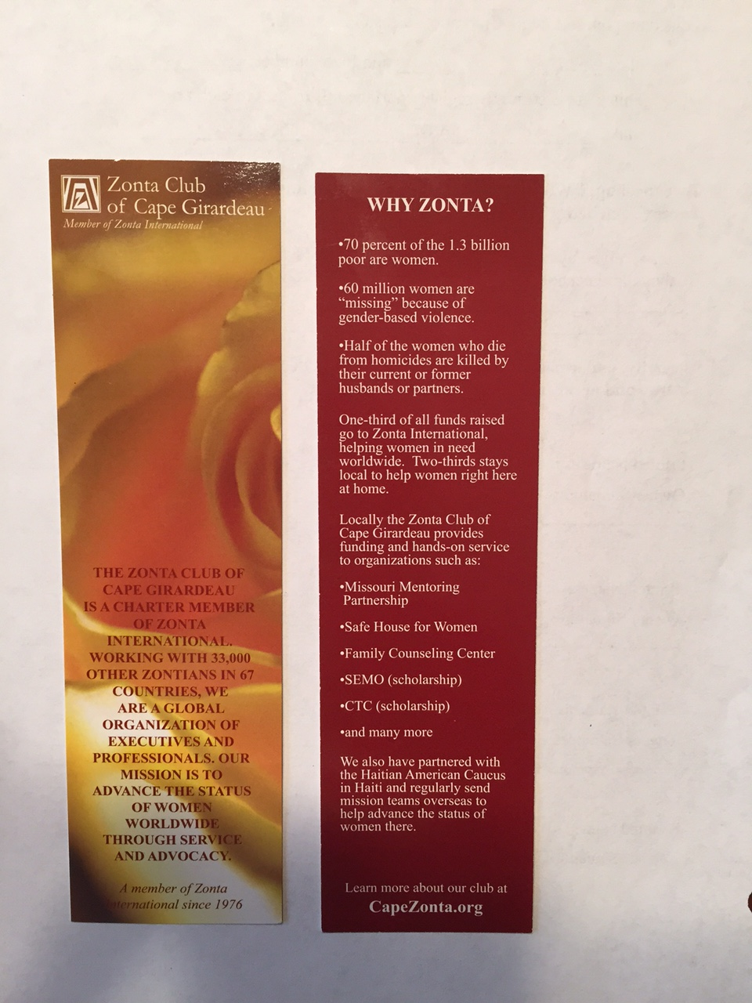

Zonta International online materials
Notes:
Zonta International has materials for purchase.
The introduction to Zonta card folds neatly to fit in any wallet, and is great to have for handing out to prospective new members.
The Zontian magazine gives members detailed information about Zonta’s International Service Projects and committee work.
These items can be purchased through the “Zonta Store” on ZI’s website.
You can also create your own materials. Bookmarks are an inexpensive way for clubs to share information. They can be given away at events and used with your elevator speech.

Slide 8

Thank You!
Remember, membership is the heart of our organization!
Notes:
Remember, allow those with skills, training, passion in Zonta, and enthusiasm in recruiting lead the way.
It is the responsibility of every club member to engage new members. Your club members need to know that they do not necessarily need to be the contact person, but everyone should be on the lookout for potential members and pass the names on to the committee or person responsible for the follow up. Sponsoring , Organizing and Mentoring is spreading the work of Zonta.
REMEMBER: BEHIND EVERY GREAT PLAN IS A NUMBER OF DEDICATED AND PASSIONATE PEOPLE.
ZONTAINS ARE THOSE PEOPLE!

